Slide 2
Process Management

Slide 3

PROCESS MANAGEMENT
PROCESSES
An application consists of one or more processes.
A process in the simplest terms is an executing program.
THREADS
A thread is the basic unit to which the operating
system allocates processor time.
A thread can execute any part of the process code,
including parts currently being executed by another thread.

Slide 4
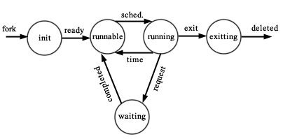
PROCESS STATES
Processes can be in any one of the following states:

Slide 5
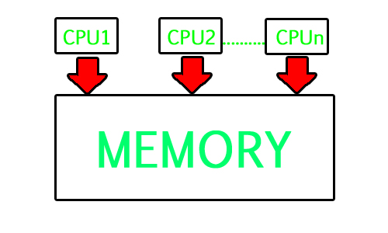

PROCESSING TYPES
MULTIPROCESSING

Slide 6
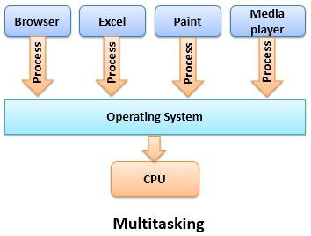

2. MULTITASKING

Slide 7
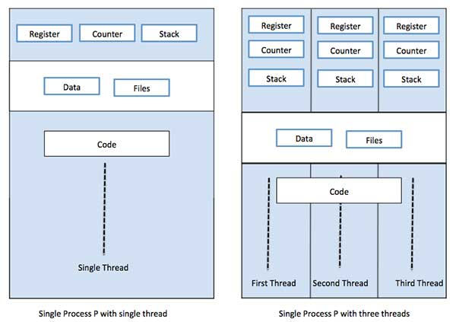
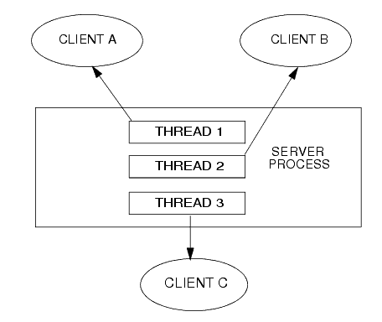
2. MULTITHREADING

Slide 8
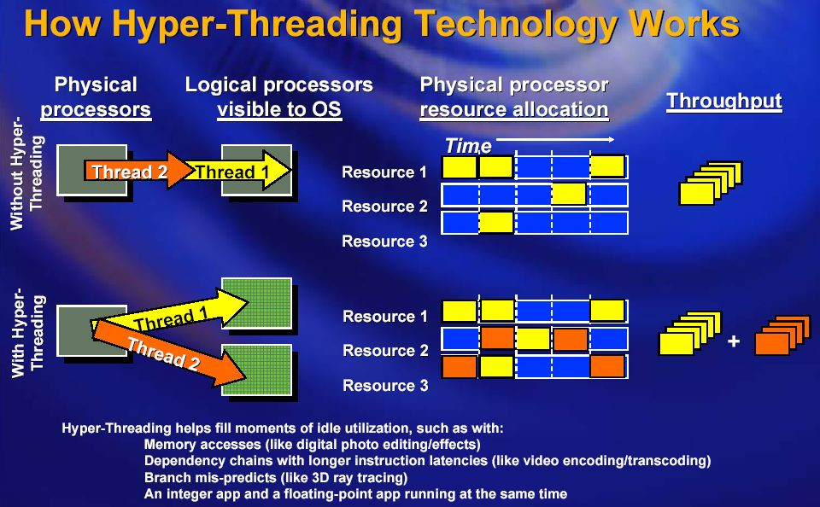
2. HYPERTHREADING

Slide 9
Memory Management

Slide 10
Virtual Address Space and Physical storage
The virtual address space for a process is the set of virtual memory addresses that it can use.
The address space for each process is private and cannot be accessed by other processes unless it is shared.
It can be smaller or larger than the total physical memory available on the computer.
Physical storage and the virtual address space of each process are organized into pages, units of memory, whose size depends on the host computer.
Notes:
Fixar a posicao do titulo – sempre do lado esquerdo.
Sempre que tiver muito texto o coluna deve sempre ser “ narrowed” , se nao fica dificil de ler. Colocar paragrafos no texto.
Linha vertical deve ser mais fina e as pontas NUNCA devem ser arredondadas.

Slide 11
Working Set
It is the set of pages in the virtual address space of the process that are currently resident in physical memory.
It contains only pageable memory allocations
Page State
The pages of a process's can be in one of the following states :
Free
Reserved
Committed
Notes:
Fixar a posicao do titulo – sempre do lado esquerdo.
Sempre que tiver muito texto o coluna deve sempre ser “ narrowed” , se nao fica dificil de ler. Colocar paragrafos no texto.
Linha vertical deve ser mais fina e as pontas NUNCA devem ser arredondadas.

Slide 12
Data Execution Prevention
It enables the system to mark one or more pages of memory as non-executable.
It prevents code from being run from data pages such as the default heap, stacks, and memory pools.
Memory Protection
Memory that belongs to a process is implicitly protected by its private virtual address space.
Copy-on-Write Protection.
Notes:
Fixar a posicao do titulo – sempre do lado esquerdo.
Sempre que tiver muito texto o coluna deve sempre ser “ narrowed” , se nao fica dificil de ler. Colocar paragrafos no texto.
Linha vertical deve ser mais fina e as pontas NUNCA devem ser arredondadas.

Slide 13
Paging
Paging is a memory management scheme that eliminates the need for contiguous allocation of physical memory.
The paging is done by the management unit (MMU).
The Physical Address Space is conceptually divided into a number of fixed-size blocks called frames.
The Logical address Space is also splited into fixed-size blocks, called pages.
Page Size = Frame Size

Slide 14
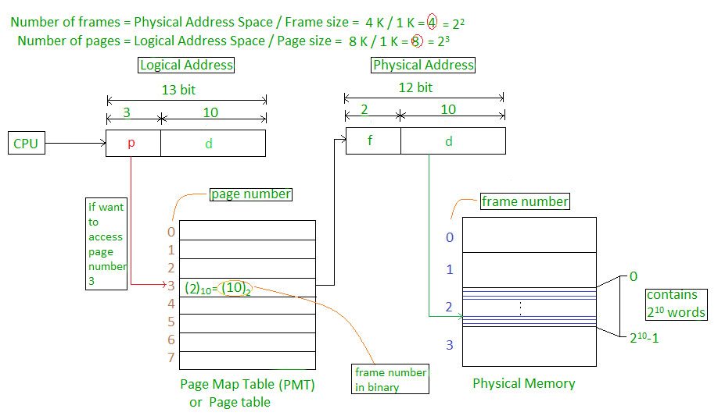
Paging Example
Physical Address = 12 bits, then Physical Address Space = 4 K words
Logical Address = 13 bits, then Logical Address Space = 8 K words
Page size = frame size = 1 K words (assumption)

Slide 15
Types of Paging
Demand Paging
Loader Paging
Anticipatory Paging
Swap Prefetch

Slide 16
Thrashing
The processor spends most of its time, swapping pieces rather than executing user instructions.
Disadvantages of thrashing :
Increases the degree of multiprogramming.
System throughput decreases.
Page fault rate increases.
Notes:
Fixar a posicao do titulo – sempre do lado esquerdo.
Sempre que tiver muito texto o coluna deve sempre ser “ narrowed” , se nao fica dificil de ler. Colocar paragrafos no texto.
Linha vertical deve ser mais fina e as pontas NUNCA devem ser arredondadas.

Slide 17
Fragmentation
Fragmentation is the inability to reuse memory that is free.
Types of fragmentation: internal and external fragmentation.
Causes of Fragmentation :
Isolated death
Time varying program behavior.
Notes:
Fixar a posicao do titulo – sempre do lado esquerdo.
Sempre que tiver muito texto o coluna deve sempre ser “ narrowed” , se nao fica dificil de ler. Colocar paragrafos no texto.
Linha vertical deve ser mais fina e as pontas NUNCA devem ser arredondadas.

Slide 18
Memory Pool
Memory pools are fixed-size blocks of memory that are thread-safe.
They operate much faster than the dynamically allocated heap and do not suffer from fragmentation.
The advantage of this is it reuse existing memory block so that reduce the times of system call.
Notes:
Fixar a posicao do titulo – sempre do lado esquerdo.
Sempre que tiver muito texto o coluna deve sempre ser “ narrowed” , se nao fica dificil de ler. Colocar paragrafos no texto.
Linha vertical deve ser mais fina e as pontas NUNCA devem ser arredondadas.

Slide 19
Types of Memory Pool
PAGED POOL :
It is the region of virtual memory that can be paged in and out of the system.
Is accessible from any process context.
NONPAGED POOL :
Consists of ranges of virtual address that reside in physical memory all the time.
Can be accessed any time.
Notes:
Fixar a posicao do titulo – sempre do lado esquerdo.
Sempre que tiver muito texto o coluna deve sempre ser “ narrowed” , se nao fica dificil de ler. Colocar paragrafos no texto.
Linha vertical deve ser mais fina e as pontas NUNCA devem ser arredondadas.

Slide 20
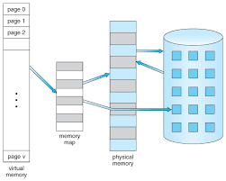
Virtual Memory
Virtual memory is the alternate set of memory addresses.
When the program is actually executed, the virtual address are actually converted into real memory addresses.
Notes:
Fixar a posicao do titulo – sempre do lado esquerdo.
Sempre que tiver muito texto o coluna deve sempre ser “ narrowed” , se nao fica dificil de ler. Colocar paragrafos no texto.
Linha vertical deve ser mais fina e as pontas NUNCA devem ser arredondadas.

Slide 21
Functions of virtual memory
Make the computer to share memory efficiently.
Eliminate a restriction that a computer works in memory which is small and be limited.
Protect programs to interfere each other in each memory area.
Notes:
Fixar a posicao do titulo – sempre do lado esquerdo.
Sempre que tiver muito texto o coluna deve sempre ser “ narrowed” , se nao fica dificil de ler. Colocar paragrafos no texto.
Linha vertical deve ser mais fina e as pontas NUNCA devem ser arredondadas.

